Slide 1

Sentimental Analysis for the Hotel Reviews
Big Data Final Project – Group 30
Submitted By:
Pavan Sai Pottimuthi (811235129)
Shirish Kumar Tallapelly (811229216)
Shiva Kumar Peddapuram (811235874)

Slide 2
Introduction:
In this era of technologies, we take lot of parameters into considerations when we buy, stay, travel to any place.
Though there are lot of parameters which can be considered we always care about the things like cost, reviews.
So, in this project we are performing sentimental analysis on hotel reviews.
So, in the same way when we travel for long distance, we try to stay in hotels which have good feedback and good maintenance and, we expect lot more parameters .

Slide 3

Problem Statement:
The project’s main goal is to perform sentiment analysis on hotel reviews collected from the Kaggle dataset.
Given a customer review, we must predict whether the review is favorable or unfavorable, or positive or negative.
We want to predict whether a textual review corresponds to a positive (satisfied) or negative review (the customer is not satisfied).
Preforming visualization on dataset by considering different parameters

Slide 4

Solution: performing Sentimental Analysis
To resolve the above problem statement initially we perform data cleaning and loading process then we perform sentimental analysis
Sentimental Analysis:
In general, Sentimental Analysis is also referred to as opinion mining, that uses techniques like machine Learning Algorithms, different types of Statistical Methods and NLP.
Sentimental Analysis is a technique which helps us to identify the emotions from the raw texts.
Sentimental Analysis plays crucial role in the domain of NLP (natural language processing), in most of the E-commerce like: Amazon, Flipkart, Shopify.

Slide 5

Types of sentimental analysis
There are lot of sentimental Analysis techniques they are:
Fine-grained Sentiment Analysis: breaks down polarity into smaller groups, usually highly positive to very negative, to provide a more specific level of polarity. This can be compared to a 5-star rating system in terms of opinion.
Aspect-based Sentiment Analysis (ABSA): When it is related to a specific property or feature described in the text, it is most useful. ABSA is the process of discovering these traits or features and their sentiment. These features are referred to as “themes” at Thematic.

Slide 6
Emotion detection: Rather than detecting positive and negative emotions, emotion detection detects specific emotions. Happiness, frustration, shock, anger, and grief are only a few examples.
Intent-based: Intent-based analysis distinguishes between facts and opinions in a text. An online comment indicating dissatisfaction with changing a battery, for example, can motivate customer service to contact you to remedy the problem

Slide 7
Sentimental Score:
We use sentimental score to define the emotions of the texts.
Sentiment score usually lies in between -1, 0, 1
-1 defines as Negative.
Here Negative in terms of sentimental analysis means the text on which we are working has negative impact.
0 represents as neutral.
Here Neutral Sentimental Score Means it has no impact on the research we are working on it.
1 represents as positive.
Positive Sentimental Score means it shows positive text is found out in our text data.

Slide 8
Data Preparation and data exploration
For the data exploration to know some statistical parameters like count mean standard deviation we use panda's.
We use dataframe.info() to get a quick overview of the dataset.
For the data visualization we use matplotlib functionand seaborn

Slide 9
Data collection
We have collected the data from Kaggle which is an open source where we can find lots of data for free.
Link for the dataset is as follows: https://www.kaggle.com/code/jonathanoheix/sentiment-analysis-with-hotel-reviews/input

Slide 10
What is hotel review?
A hotel review is generally described as the brief statement expressing a person's evaluation of their experience staying at a particular hotel
Hotel review evaluations typically contain feedback on the overall experience by the guests

Slide 11
Dataset
The following attributes are considered as our dataset:
Hotel-Address ReviewTotalPositiveWordCounts
Review-Date Average-Score
Hotel-Name Reviewer-Nationality
Negative-Review ReviewTotalNegativeWordCounts
Positive-Review ReviewTotalPositiveWordCounts
Reviewer-Score TotalNumberofReviewsReviewerHasGiven
TotalNumberof-Reviews Tags
Dayssincereview AdditionalNumberof-Scoring
Latitude Longitude

Slide 12

Proposed Model
The research began with an examination of lot of research and review articles on sentiment analysis, and each publication's summary was prepared by reading and comprehending the document.
we will Examine the more popular classification methodologies such as Random Forest and Transformers using RoBERTa.

Slide 13

Data Cleaning
In Data cleaning we usually clean and preprocess the dataset.
01
We use the Doc2vec function for converting text to vectors which is a part of gensim module.
02
We plot the word Cloud and polarity score by using SentimentIntensityAnalyzer
03

Slide 14
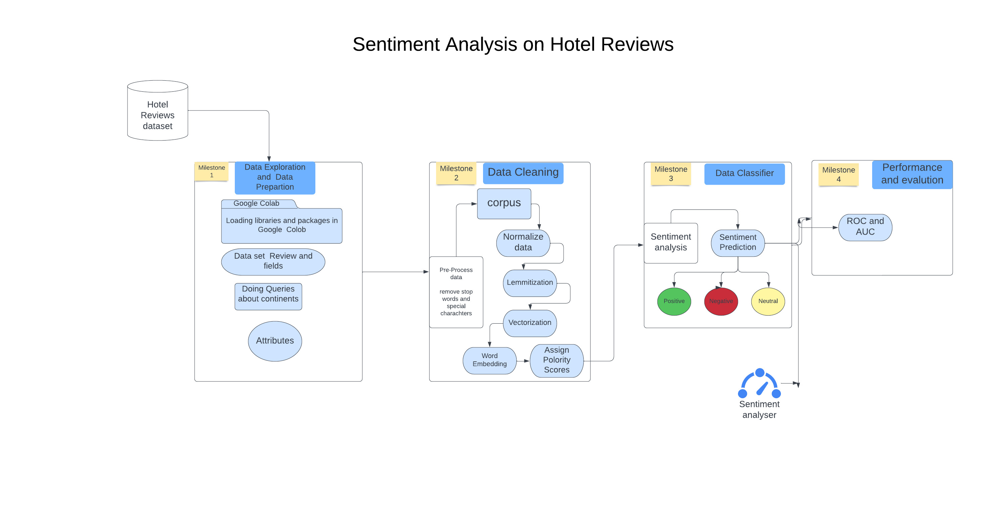
System Architecture

Slide 15
Performance & Evaluation
For the performance and evaluation, We will use ROC(Receiver Operating Characteristics) curve and AUC ( Area Under the Curve)
Through this we can evaluate false positive rate & true positive rate for each feasible cut-off value

Slide 16

Key concepts:
NLP(Natural Language Processing)
It has ability to not just read but understands and interpret human language.
NLP tools process data in real time, 24/7, and apply the same criteria to all your data, so you can ensure the results you receive are accurate – and not riddled with inconsistencies.

Slide 17
Bag of Words (Bow)
Raw text is initially preprocessed by using processing and cleaning techniques.
In this step we remove all unnecessary data like special characters, if there are words of other accent like polish, German, Spanish etc.
Removes, replace them or add the right Unicode to make them readable for machine.
Bag of words is a text analysis technique. It shows a collection of words which are of not grammar and word order. It uses the tokenization technique of large text into words and then counting the frequency of each word in a document

Slide 18

Classifier
We will use Random forest as a learning method (it can be used for both classification and regression tasks)
It makes group of decision trees, usually trained with the “bagging” method

Slide 19

Random Forest:
Random forest is flexible, easy to use machine learning algorithm that produces, even without hyper-parameter tuning.
The "forest" it builds, is an ensemble of decision trees, usually trained with the “bagging” method

Slide 20
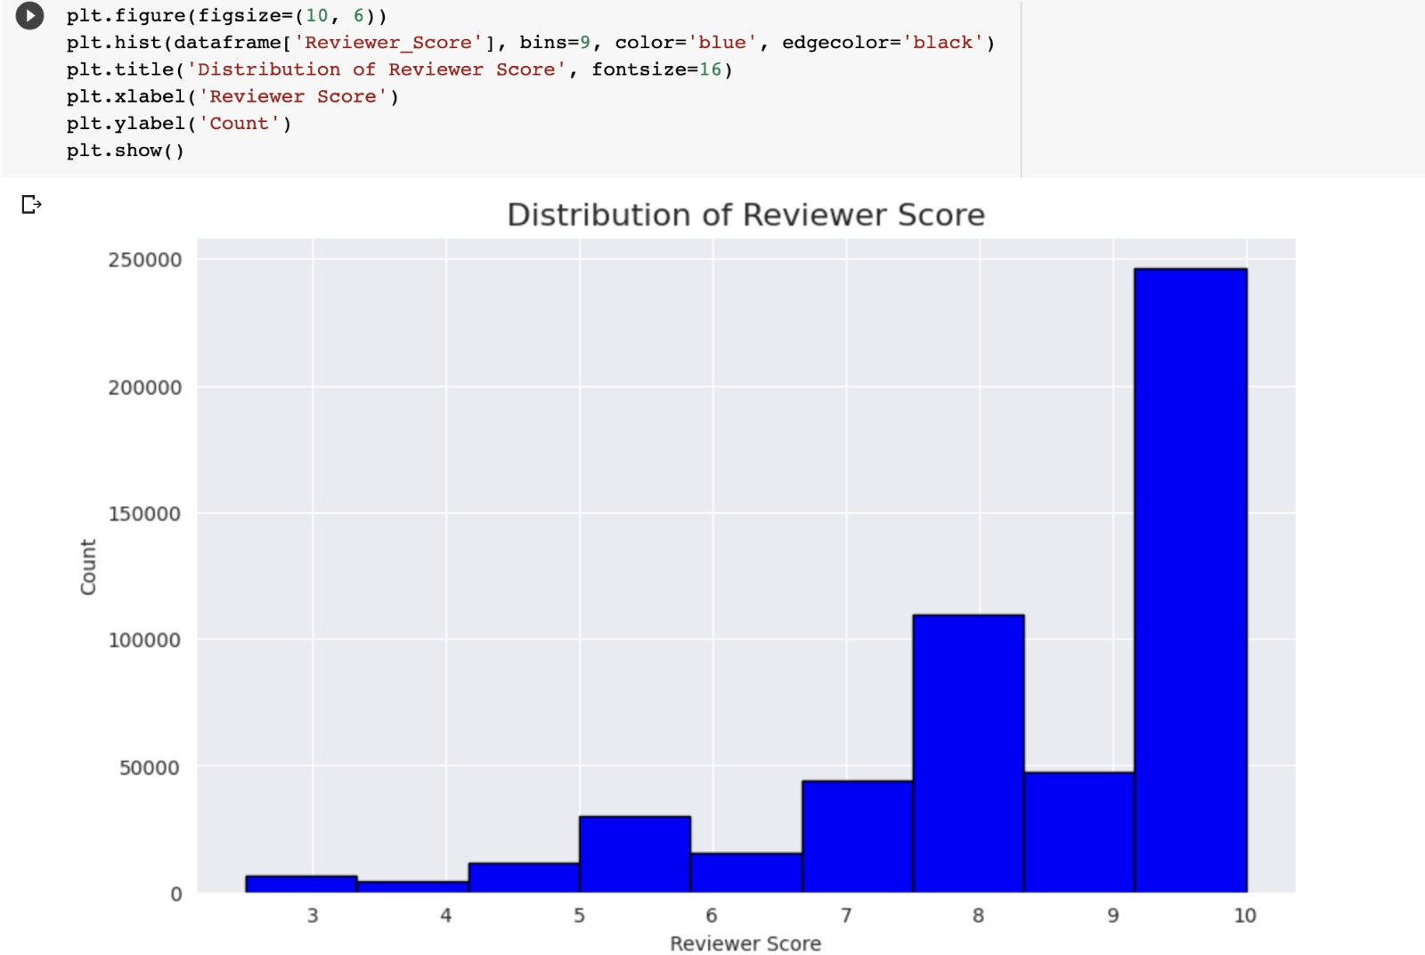
Distribution Of Reviewer Score
Notes:
In this visualization we can see the distribution of the reviewer score which starts from 0 and ends till 10

Slide 21
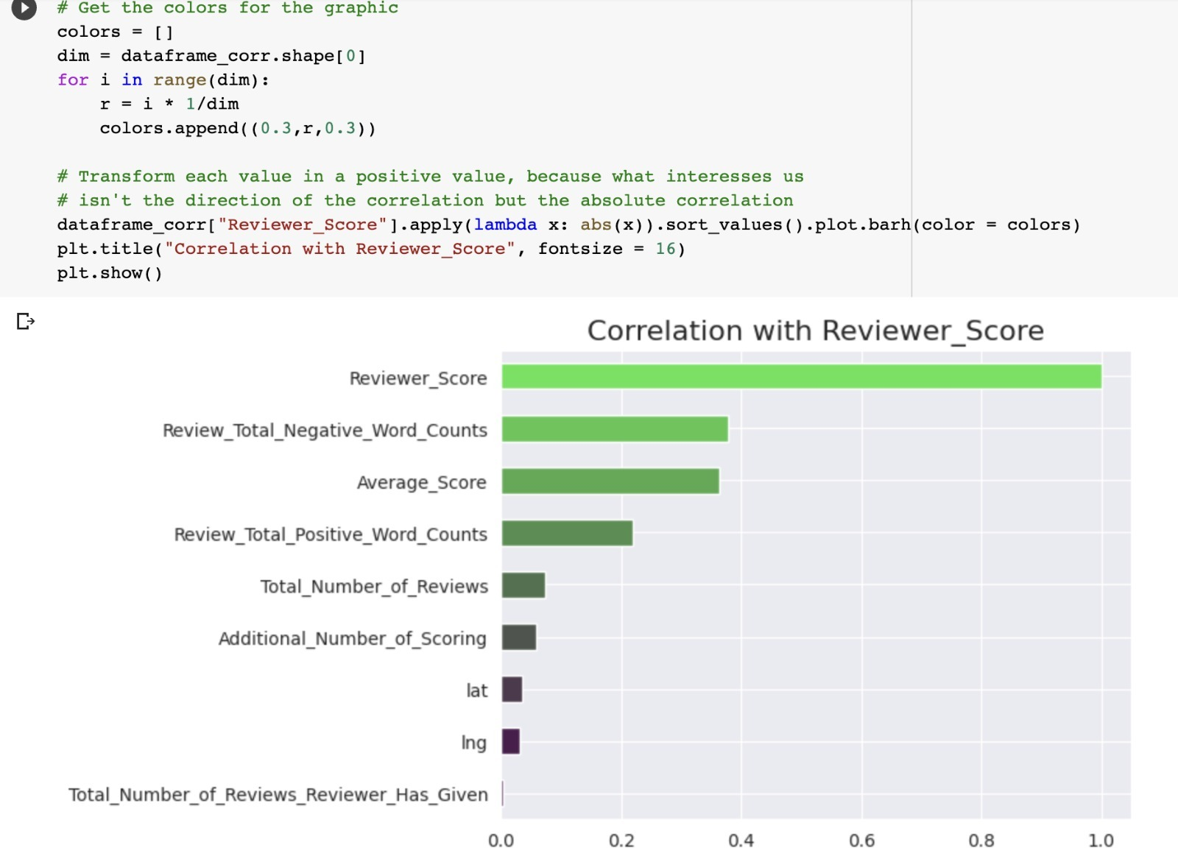
Correlation with Reviewer_score

Slide 22
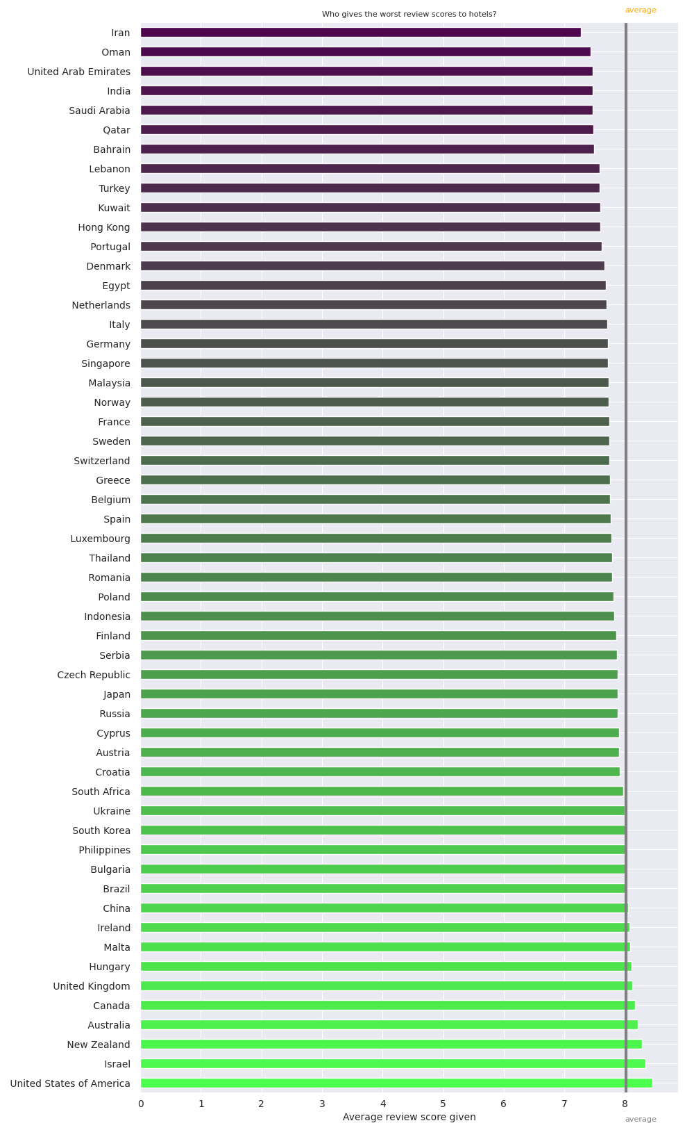
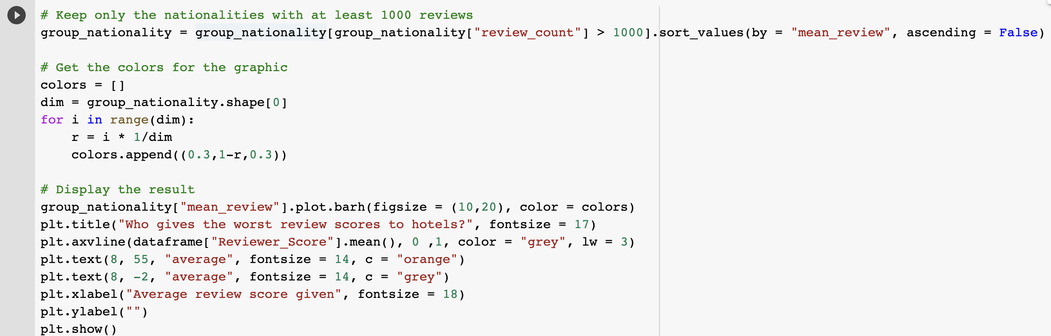

Slide 23
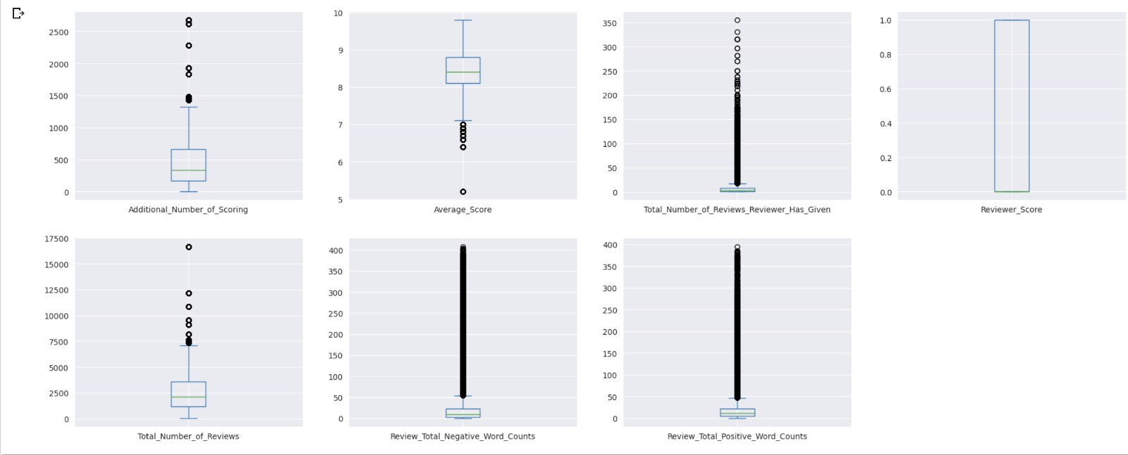
dataframe[['Additional_Number_of_Scoring','Average_Score',
'Total_Number_of_Reviews_Reviewer_Has_Given','Reviewer_Score','Total_Number_of_Reviews','Review_Total_Negative_Word_Counts','Review_Total_Positive_Word_Counts']].plot(kind = "box" , subplots = True , figsize = (24,20) , layout = (4,4))
plt.show()
Notes:
Box plot : circles outliers
Line indicate mean first and 3rd mean

Slide 24
dataframe[['Additional_Number_of_Scoring','Average_Score',
'Total_Number_of_Reviews_Reviewer_Has_Given','Reviewer_Score','Total_Number_of_Reviews','Review_Total_Negative_Word_Counts','Review_Total_Positive_Word_Counts']].plot(kind = "box" , subplots = True , figsize = (24,20) , layout = (4,4))
plt.show()
Notes:
Box plot : circles outliers
Line indicate mean first and 3rd mean

Slide 25
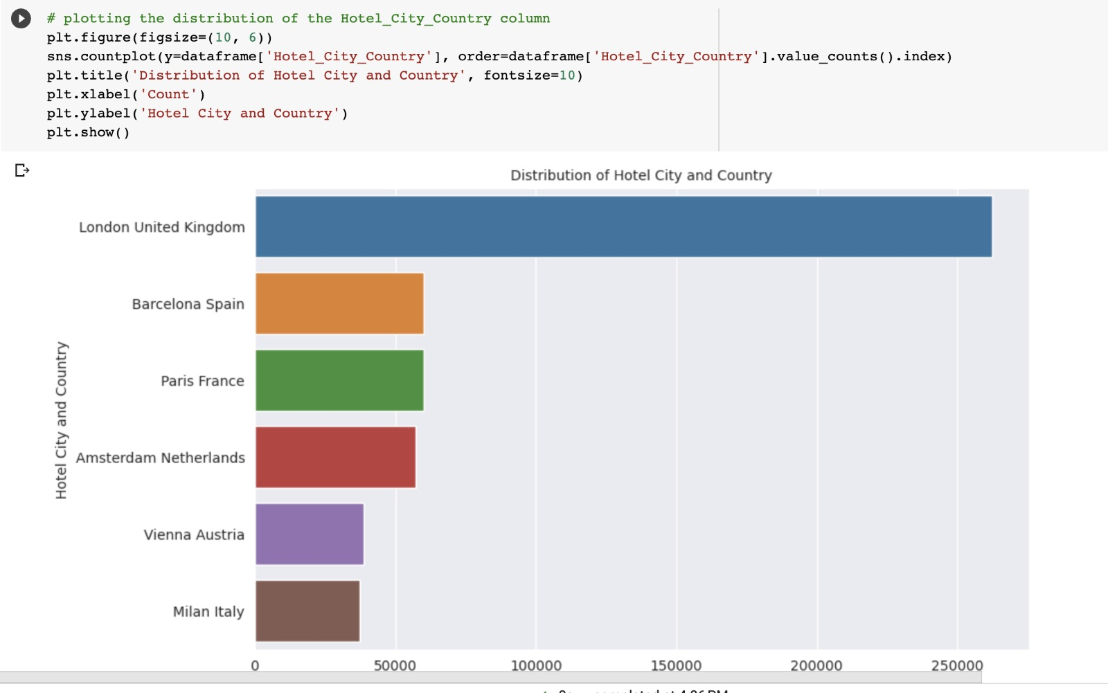
Plotting the distribution of the Hotel_city_country column
Notes:
In this visualization it shows about the distribution of hotel city and country

Slide 26
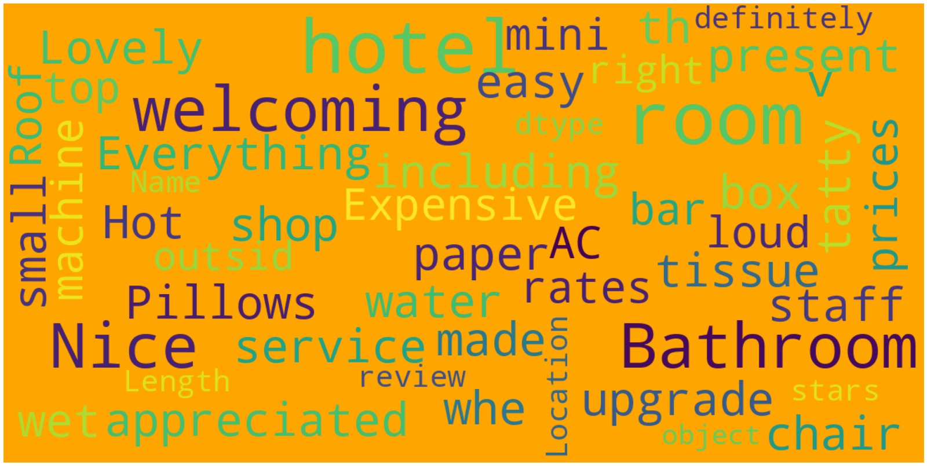
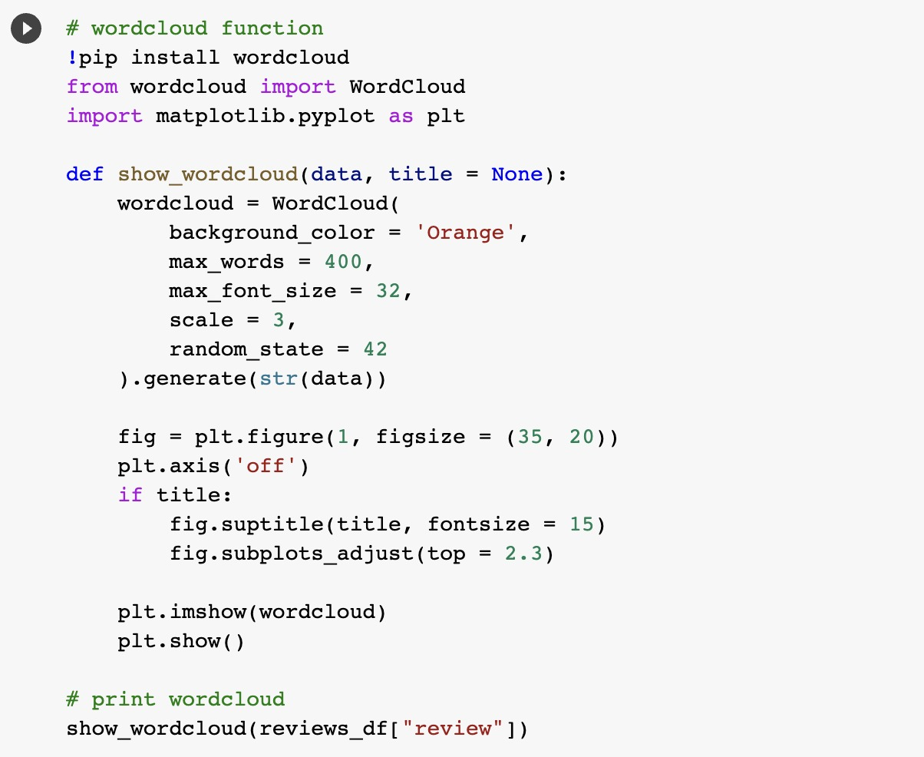
Wordcount Function
Notes:
By using wordcount function we can get to know what are the words that have been used more in the given reviews like: good welcome paper expensive.

Slide 27
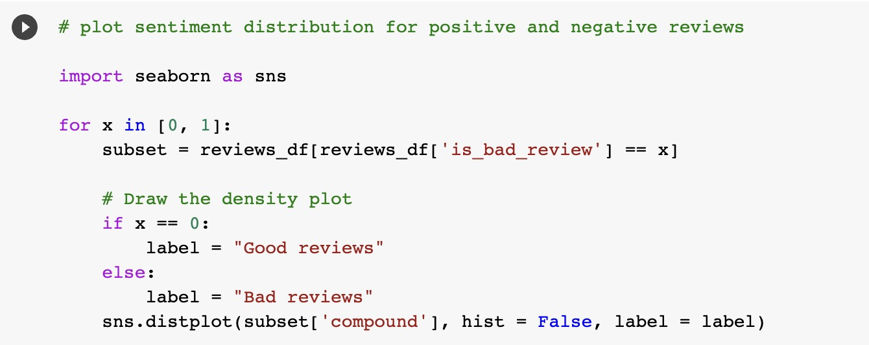
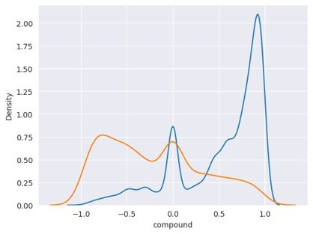
Plot for sentiment distribution for positive and negative reviews
Notes:
In this plot we can see that sentimental score has been showed that is if it is good review then the sentimental score will be 1 and if it is bad review then it will show as –1 if it is neutral then it shows as 0

Slide 28
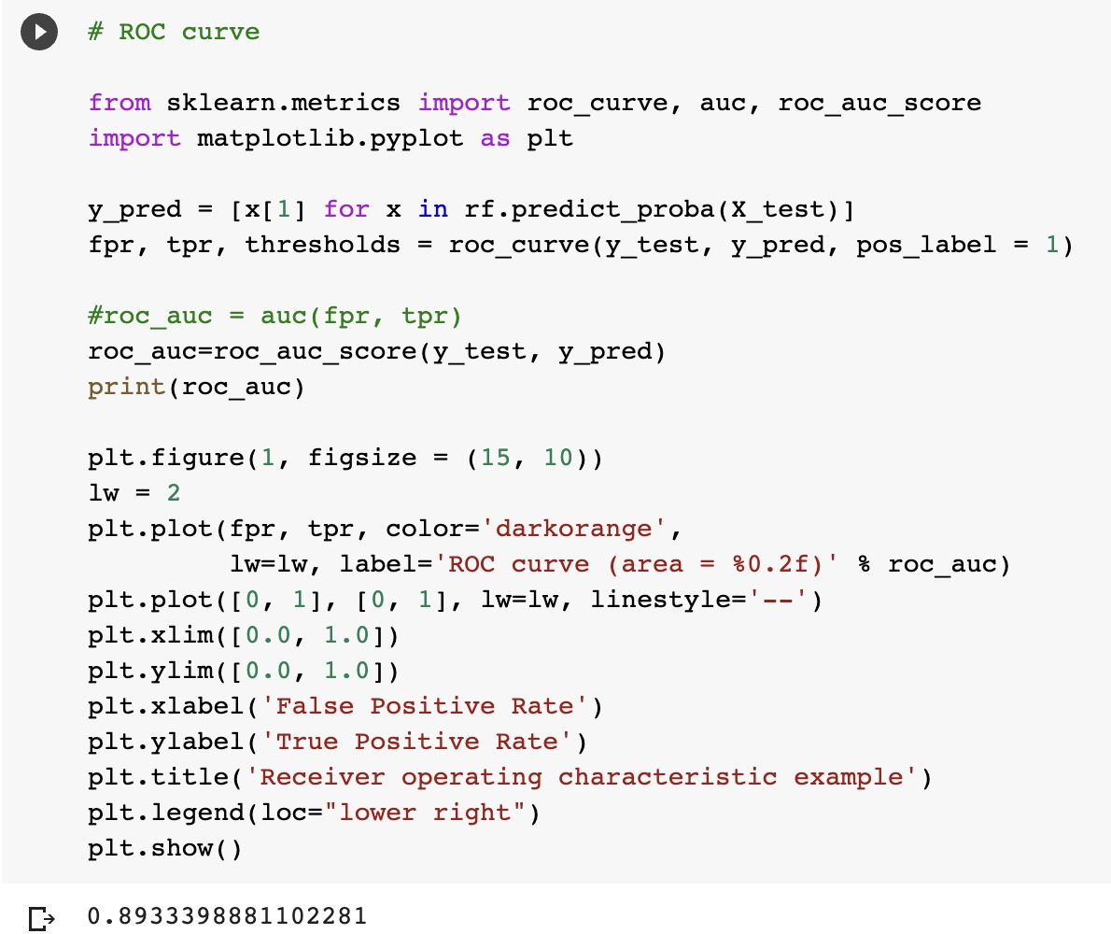
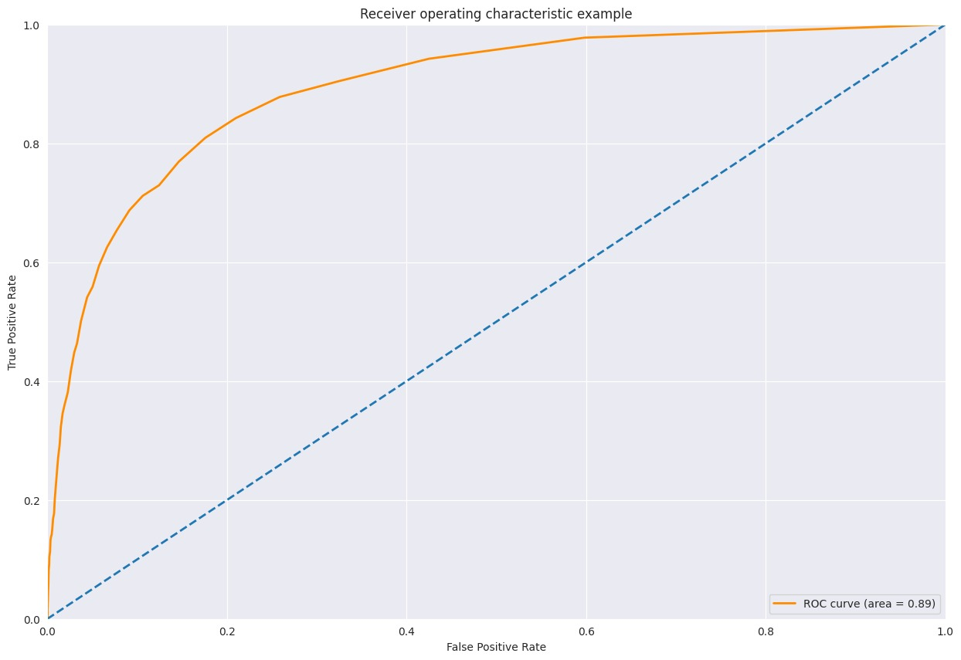
Roc curve
Notes:
The ROC (Receiver Operating Characteristic) curve is usually a good graph to summarize the quality of our classifier. The higher the curve is above the diagonal baseline, the better the predictions. Although the AUC ROC (Area Under the Curve ROC) is very good, we should not use here the ROC curve to assess the quality of our model.
Why?

Slide 29
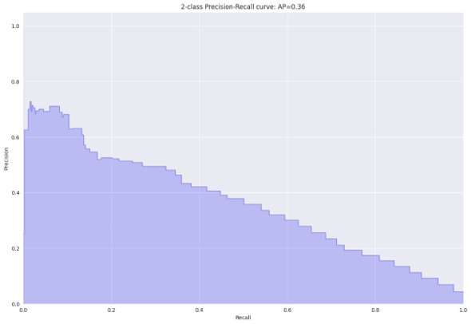
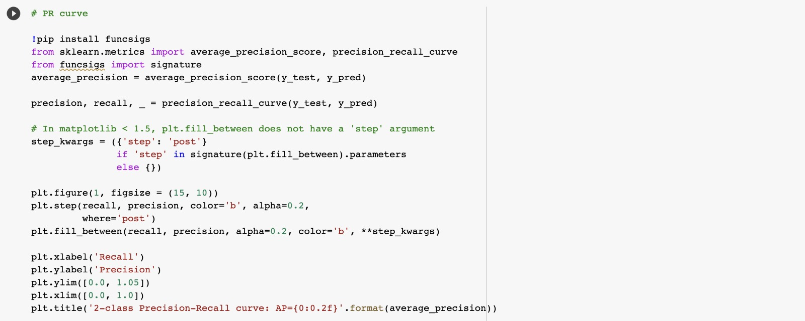
PR curve
Notes:
Plot showing Precision-Recall (PR) Curve –
Precision is the proportion of correct positive classifications (true positive) divided by the total number of predicted positive classifications that were made (true positive + false positive). Recall is the proportion correct positive classifications (true positive) divided by the total number of the truly positive classifications (true positive + false negative).
A PR curve is simply a graph with Precision values on the y-axis and Recall values on the x-axis. In other words, the PR curve contains TP/(TP+FP) on the y-axis and TP/(TP+FN) on the x-axis.
It is important to note that Precision is also called the Positive Predictive Value (PPV).
Recall is also called Sensitivity, Hit Rate or True Positive Rate (TPR)
The precision-recall curve shows the tradeoff between precision and recall for different threshold. A high area under the curve represents both high recall and high precision, where high precision relates to a low false positive rate, and high recall relates to a low false negative rate.
Precision-Recall curves should be used when there is a moderate to large class imbalance.

Slide 30
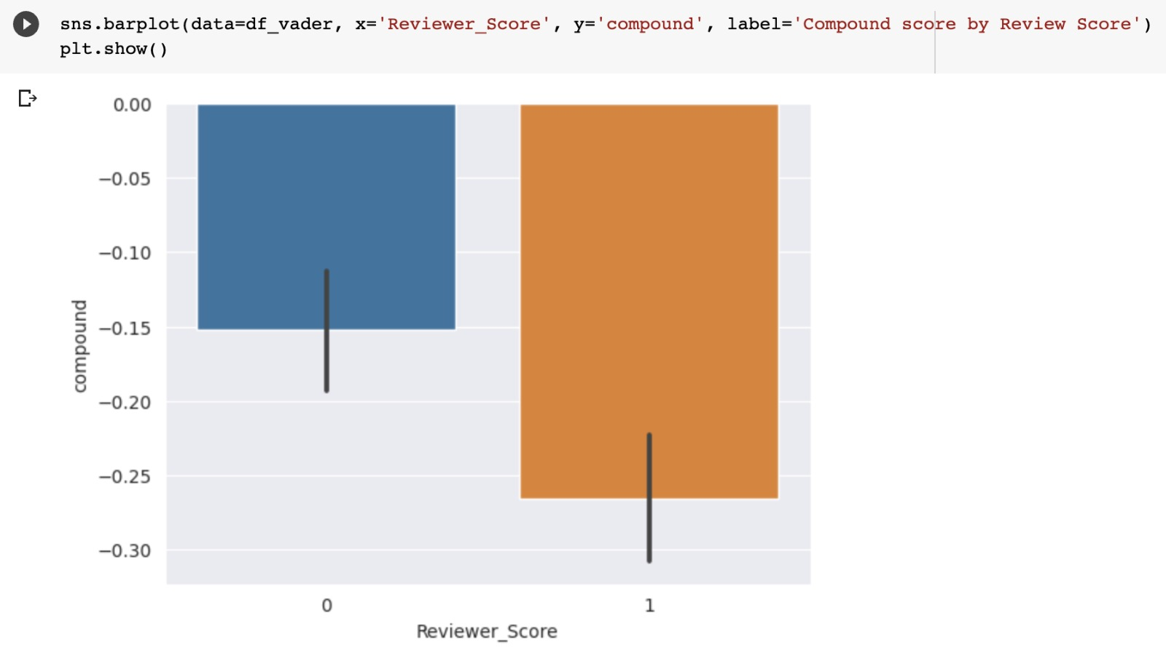
Barplot for reviewer score and compound
Notes:
If we assume the Review Score of 5 is more like positive sentiment than negative, we want the Compound score also to be higher. low Score has lower Compound and Higher Score has higher Compound

Slide 31
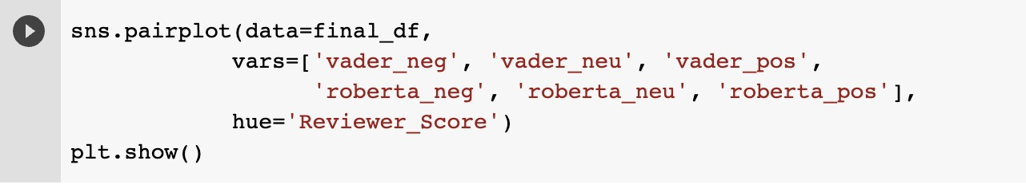
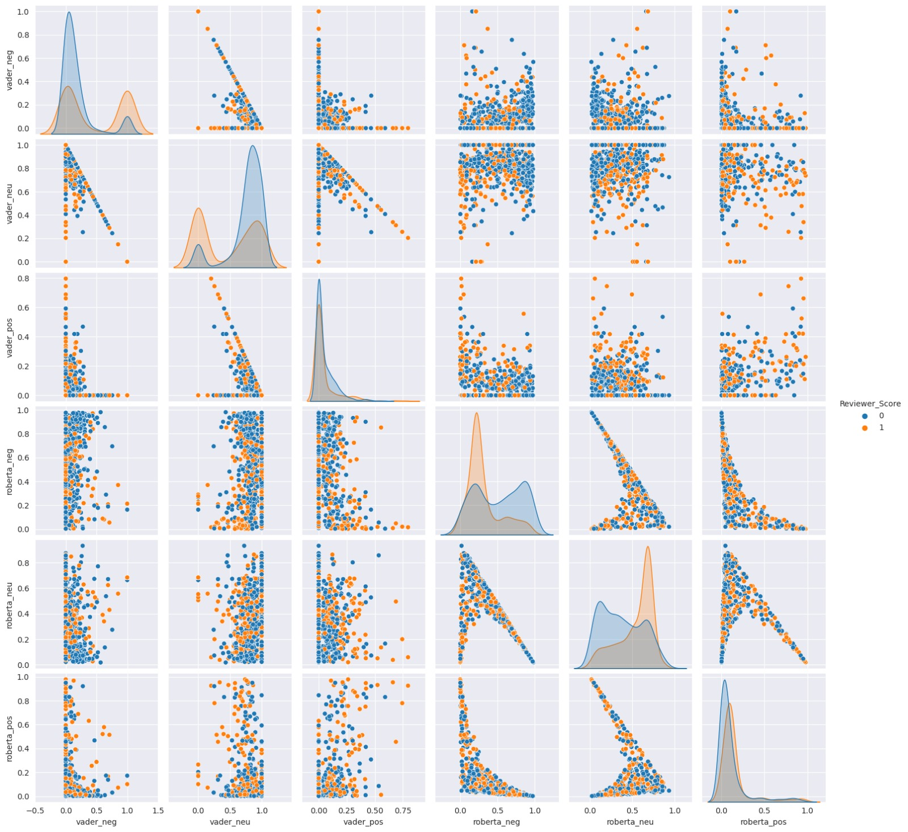
Plot showing in between vader and roberta
Notes:
Graph using roberta

